Slide 1


Complexity Question Detection Intermediate presentation
Author: Andrada-Ioana Cojocaru
Thesis advisor: Ș.L.dr.ing. Ștefan Rușeți
BUCHAREST​ 2024​
University Politehnica of Bucharest

Slide 2
Table of contents
01
02
03
Topic
Results
Future development
Presentation on this subject in general.
The results obtained.
The plan for the final presentation.

Slide 3
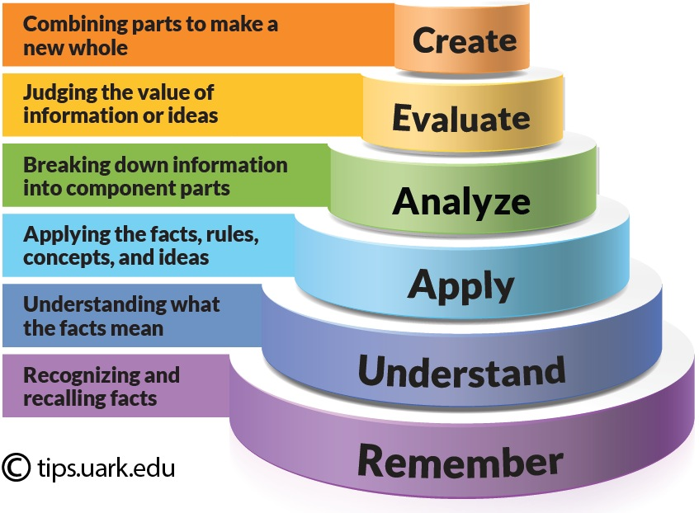
01
Complexity Question Detection using Bloom’s Taxonomy
Problem
Detect the complexity of a question using the categories of Blooms taxonomy.
Solution
Create a classificator using LLM and prompt engineering techniques to obtain the best results, using the EduQG dataset, that only contains data from 4 categories - "Knowledge", "Comprehension", "Application", "Analysis" .

Slide 4
Results
02
Models
List with verbs specific for every category
llama3.1:70b
llama3.2:3b
qwen2.5:1.5b
F1 score = 0.6289
Best result
llama3.1:70b F1 score = 0.6580
EduQG
3,397 multiple-choice questions.
Labeled manually for cognitive complexity based on Bloom’s Taxonomy.

Slide 5
Future development
03
Analyse faulty predictions
Modify prompt
Created a file with the faulty predictions and look at them to modify the prompt.
For the faulty predictions modify the prompt to get the correct classification.

Slide 6
Thanks!
Do you have any questions?
andrada.cojocaru@stud.acs.upb.ro

